Slide 1
Home Learning at The Meadows Class 1 and Class 2 Wednesday 15th January 2020

Slide 2
What is the purpose of home learning?
The aim of home learning is to help your child to practise, consolidate and extend their learning in school.
Practise aids long term retention.
It helps you to understand more clearly the expectations of your child and their learning so that you can see the progress that they are making.
Research suggests that increase pupils’ self-esteem, self confidence and understanding as their achievements are valued by both home and school.
It helps to enable our pupils to be “Secondary Ready” when they reach the end of their primary education journey.

Slide 3
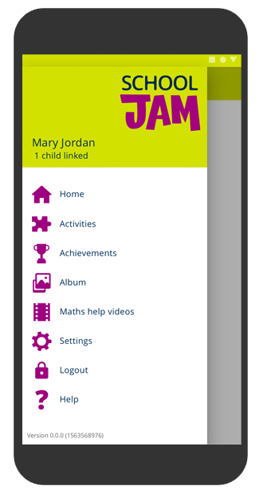
Engaging with your child’s learning through fun activities!

Slide 4
What is School Jam?
It’s an app for parents through which your child’s teacher sends you a weekly maths activity to try with your child, linked to what they are learning in school.
It includes maths help videos especially written for you, so that you can support your child with maths.
School Jam is fun for you and your child to do together!

Slide 5
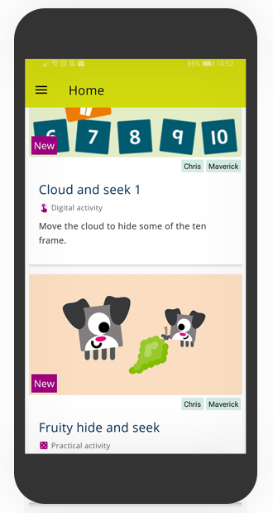
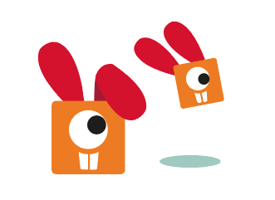
You will receive one activity per week.
All of the short, fun activities are designed for you and your child to do together.

Slide 6
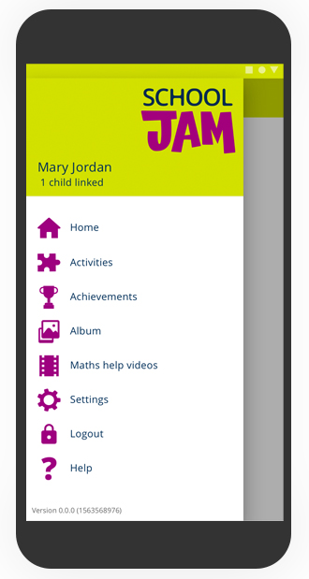
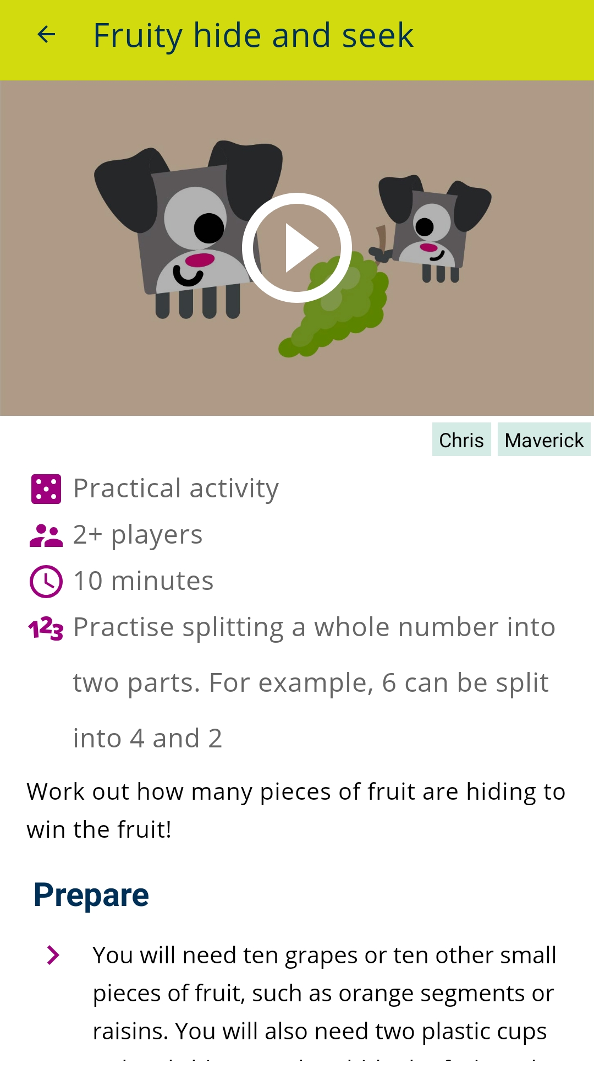
Activities are either practical …
Practical activities have either a fun demo video or clear images to help explain how to do the activity.
Activities might require you to gather simple items from around the home, such as paper or toys.

Slide 7
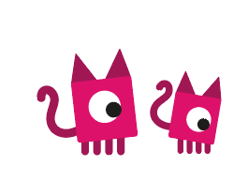
All practical activities have a ‘take it further’ element if you want to give your children more of a challenge.
You can use the School Jam app to tell your child’s teacher when you’ve done the activity.

Slide 8
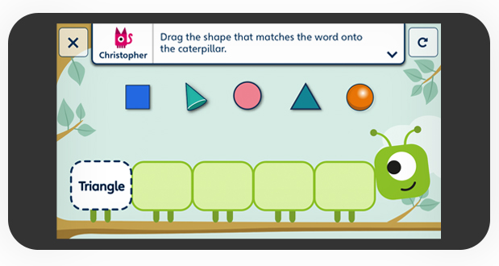
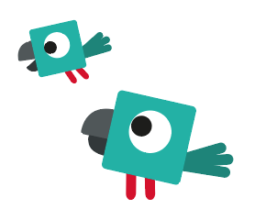
… or digital.
In this example, you work together to match the shapes to the words on the caterpillar.

Slide 9
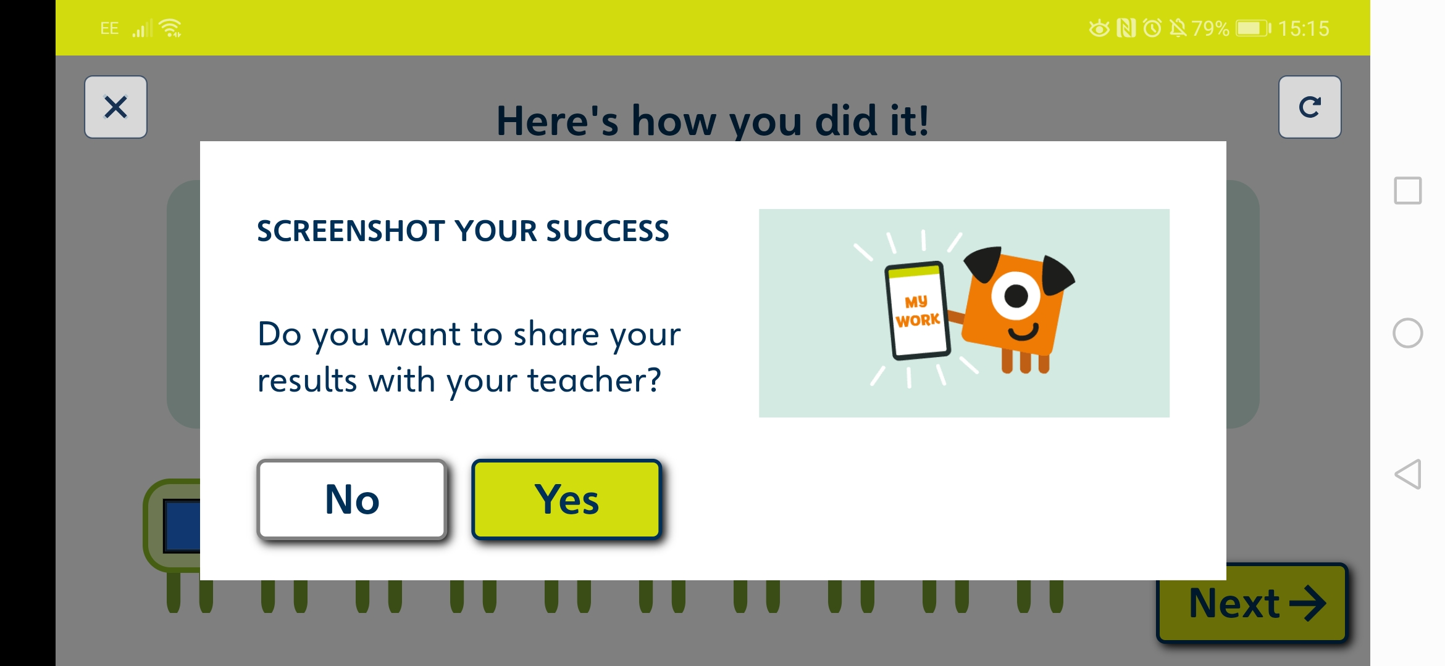
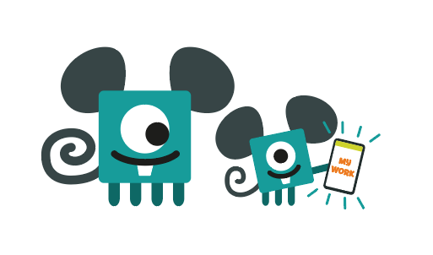
You can send a screenshot of your work to the teacher when you’ve completed the activity.
Your teacher might use these as a lesson starter, or to prompt a maths discussion in class.

Slide 10
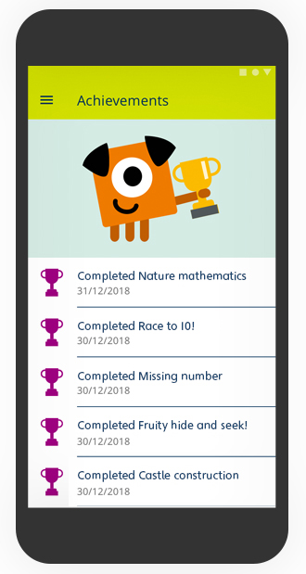
Celebrate your achievements
Collect trophies as you and your child complete the activities.

Slide 11
You can also watch maths help videos.
These short videos explain maths methods and support what your child is learning in class.

Slide 12
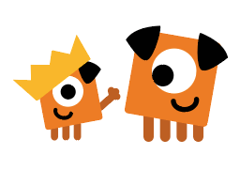
How to get started!
Download School Jam for free from the App store or Google Play.
Look out for your child’s code in their book bag.
Fill in your details and your child code on the app – then get ready to do some fun activities!

Slide 13
Why have we chosen to use the School Jam app?
It is fully aligned with our Power Maths scheme of learning.
It is based upon the CPA approach to learning, which is the basis of our learning in Maths at The Meadows. We fully believe that it enables pupils to develop conceptual understanding.
It promotes computer literacy and the development on computing skills.
It is aimed at being fun and engaging – we want our pupils to love learning Maths.
The parental videos are clear and informative.

Slide 14
Expectations of home learning in Class 1 and Class 2.
Tasks will be sent home each week by your child’s teacher.
Children are expected to complete a weekly home learning task.
Record that your child has completed the task in their home-school book.
Take a screen shot (where applicable) so that your teacher can see asses your child’s learning.

